Slide 1
Electronic buoy
Bennet Möller – No. 1121551
Emil Konrad Wlazlo – No. 1121552
Mateusz Tarkowski – No. 1121556
Toon Van den Bleeken – No. 1121560

Slide 2
Introduction
Team 3:
  Bennet Möller, International Purchases and Sales Engineering
  Emil Konrad Wlazlo, Mechanical Engineering and Applied Computer Science
  Mateusz Tarkowski, Mechanical Engineering and Applied Computer Science
  Toon Van den Bleeken, Building and Civil Engineering

Slide 3
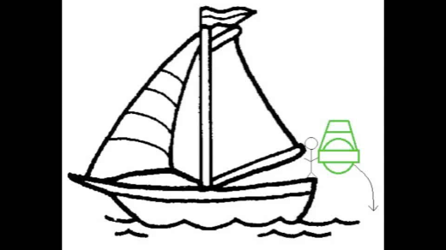
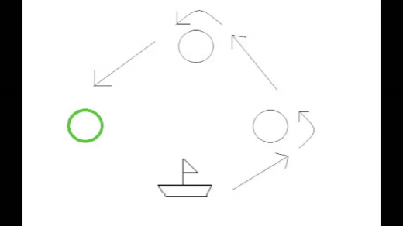
Introduction
Project description
  2 functions
  reconfigarable
Motivation
Environmental mode
Regatta mode

Slide 4
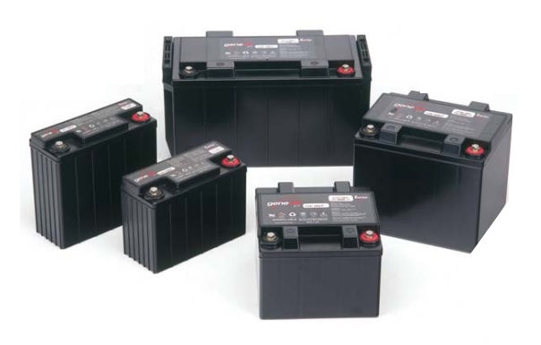
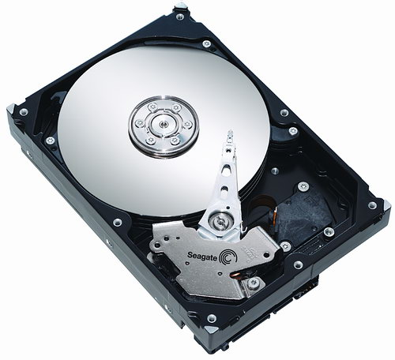
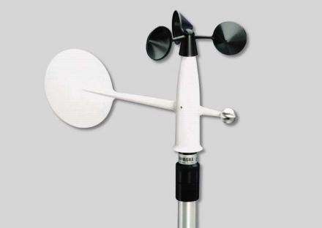

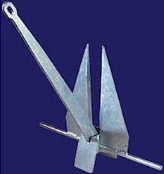
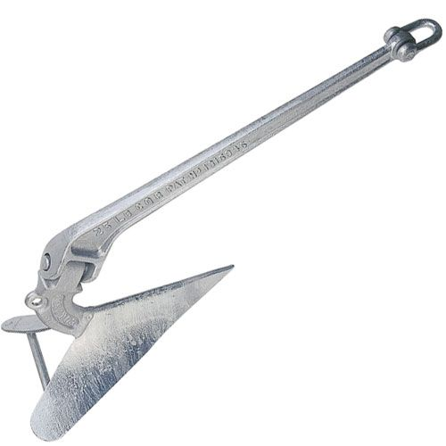
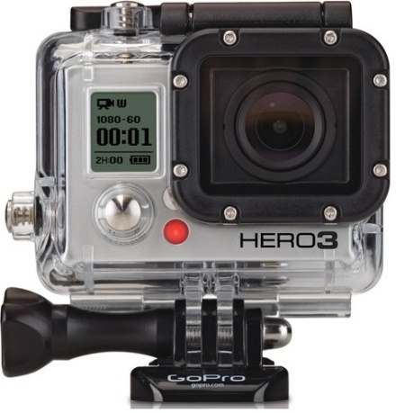
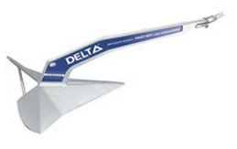
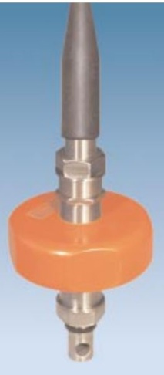
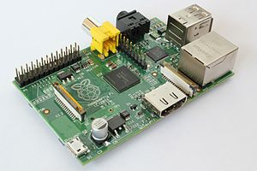
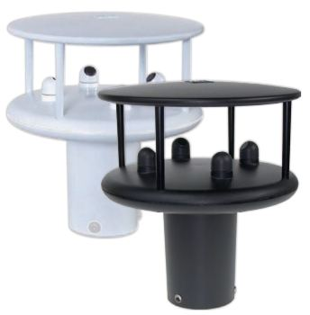
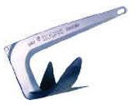
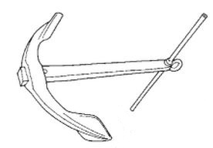
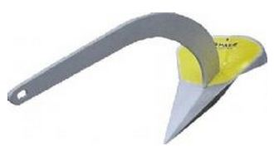
State of the Art
Product name | STM32VL Discovery | STM32F3 Discovery | STM32F4 Discovery | Raspberry Pi B | Arduino Uno
Price [€] | 8 | 13,5 | 12 | 28 | 17
Voltage needed [V] | 5 or 3.3 | 5 or 3 | 5 or 3 | 5 | 3,3 or 5
Working temp. [°C] | -40 to +85 | -40 to +85 | -40 to +85 | 0 to +70 | -40 to +85
Microcontroller: - Flash memory [kB] - RAM [kB] - core frequency [MHz] - number of pins [-] - max current consumption [mA] -supported interfaces (number): | STM32F100RBT6B 128 8 24 64 15,4 - I2C (2) - USART (3) - SPI (2) - CEC (1) | STM32F303VCT6 256 48 72 100 66,2 - I2C (2) - USART (3) UART (2) - SPI (3) - CEC (1) - I2S (2) - CAN (1) - USB (1) | STM32F407VGT6 1024 192 168 100 93 - I2C (3) - USART (4) - UART (2) - SPI (3) - CEC (1) - I2S (2) - CAN (2) - USB (1) - SDIO (1) - ethernet (1) | ARM1176JZF-S ? 512*1024 700 26 ?? - I2C (1) No info - UART (1) - SPI (1) No info No info - USB (2) - SDIO (1) - ethernet (1) | ATmega328 32 2 16 0,2 - I2C (2) - USART (1) - SPI (1)
Number of I/O | 51 GPIOs | 45 normal GPIOs, 42 5V tolerant GPIOs | 82 GPIOs | 8 GPIOs | 14 digital I/O, 6 analog inputs
Fixed interfaces |  |  |  | - HDMI - LAN - RCA video
Special features |  | - accelerometer - gyroscope - e-compass | - accelerometer - 2 motion sensors - microphone | - SD card socket
Anchors
Product name | Superyacht Underwater Colour Surveillance System | GoPro Hero 3 - black edition- | Logitech HD Webcam C270
Price [€] | 250 | 449 | 19,99
Dimensions (l x w x h) [mm] | 188 x 40 x 95.5 | 59 x 41 x 21,2 | /
Weight [g] | 363 | 73 | /
Power supply voltage [V/mAh] | 12 / 500 | / | /
Energy consumption [W] | 24 | / | /
Waterproof [yes/no] | Yes | Yes | No
UV-proof [yes/no] | Ues | No | No
Working temp. [°C] | -5 to 70 | / | /
Others: Interface Resolution Waterproof (depth) Battery type | 420p 20m | USB/SD 1080p 60m 1050mAh lithium-ion | - USB
Special features | 9 LEDs | Ultra wide angle Ultra sharp Internal memory Waterproof housing
Advantages | Small Integrated datalogger | HD Housing | - Price
Disadvantages | Price Energy consumption Dimension | Power consumption Price Charging option
Batteries
Camera
Communication
Control unit
Data storage
Sensors
Wind speed and direction sensor
Buoy orientation sensor
Air temperature sensor
Air pressure sensor
Current speed and direction
etc.
 | Hard disk WD MY PASSPORT | Optical disk |  | Flash drive Toshiba USB 3.0 Flash Drive | Flash memory card Sandisk SDHC Extreme
 |  | CD | DVD
Maximum capacity | 500 GB | 700 MB | 4,7 | 32 GB | 32 GB
Data transfer speed (MB/s) | 30-40 | 7,8 | 1,3 | 100 | 30
Dimensions (mm) | 83 x 110 x 15 (w x d x h) | 120 x 1,2 (diameter x h) | 120 x 1,2 (diameter x h) | 21 x 69 x 10 (w x d x h) | 24 x 32 x 2.1 (w x d x h)
Weight (g) | 140 | 15 | 15 | 15 | 2,5
Power consumption for transferring data | High | High | High | Low | Low
Price | €90 | < €1 | 1€ | €30 | €25
 | Lead-acid | Nickel-cadmium (NiCd) | Nickel-metal-hydride (NiMH) | Lithium-ion (Li‑ion) | Li-polymer
Specific energy density (Wh/kg) | 30-50 | 45-80 | 60-120 | 150-190 | 130–200
Cycle life | 200-300 | 1000 | 300-500 | 1200 | >1000
Fast-charge time (h) | 8-16 | 1 | 2-4 | 1 or less | 1 or less
Nominal cell voltage (V) | 2 | 1,2 | 1,2 | 3,6 | 3,6
Self-discharge/month (%) | 5 | 20 | 30 | 5 | 5
Toxicity | Very high | Very high | Low | Low | Low
Price | Moderate | Low | High | High | Very high
 | GSM | UMTS | Wi-Fi | Bluetooth
Max range [m] | 35 000 | ?? (a little less than GSM) | 150 | 100
Max data capacity [Mb/s] | 0,23 (EDGE) | 21,6 | 1024 | 40
Power consumption | high | high | moderate | low
Need of in-between device | yes | yes | No (Wi-Fi Direct) | No
Cost of module (€) | 50 - 150 | 100 - 550 | 10 - 50 | 5 - 90

Slide 5
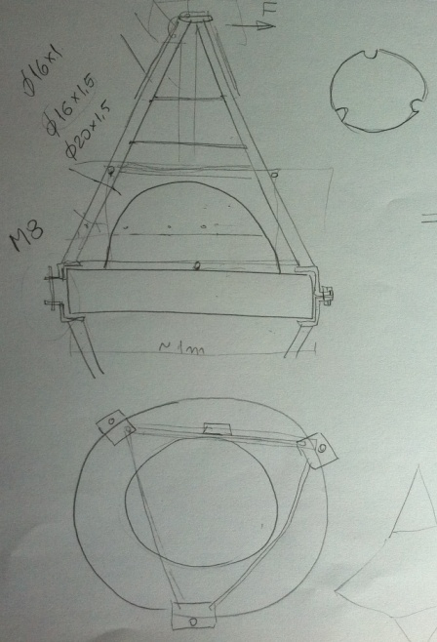
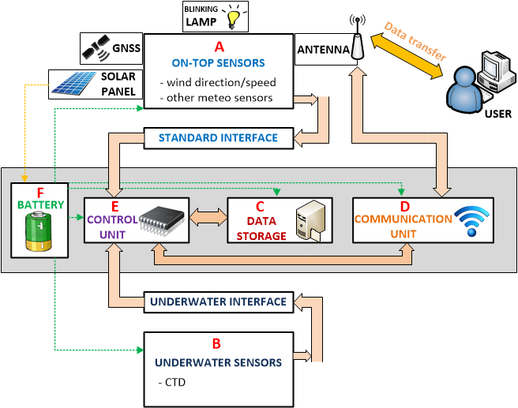
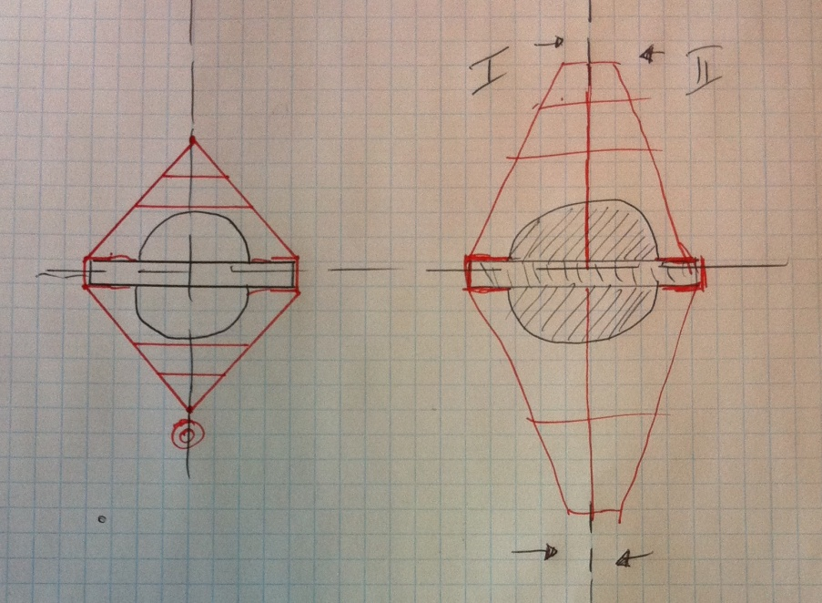
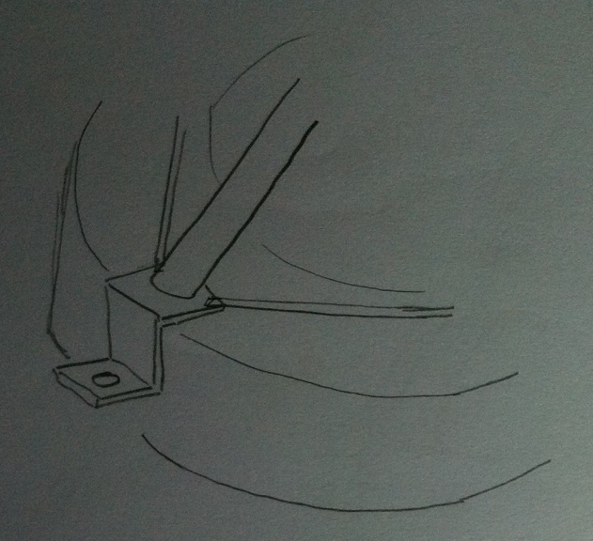
Project Development
Materials
Architecture
Steel structure
Electronics
Part | Product | Price | Quantity | Source
Fiberglass hull | Fiberglass hull | €0 | 1 | LSA
Steel structure | Stainless steel | +/- €600 | 1 | ISEP
Anchor for sand bottom | Danforth standard galvanized anchor | €19 | 1 | www.defender.com
Anchor for rock bottom | Lewmar Horizon Claw Anchor | €32 | 1 | www.defender.com
Wind speed and direction sensor | Mechanical wind speed and direction sensor | €0 | 1 | LSA
CTD sensor | Developed by a professor at ISEP | €0 | 1 | LSA
Battery | Lithium-polymer battery | €0 | ? | LSA
Microcontroller | STM32F3 Discovery kit | €13,5 | 1
Data storage | Flash memory card | ? | 1

Slide 6
Marketing Plan
Adapted Marketing Mix
Market Analysis
Businesses/ Tourism
1st objective
Planning
2nd objective
Strategy/ Positioning
Autonomous Sailing Boat
Professional Sailing

Slide 7
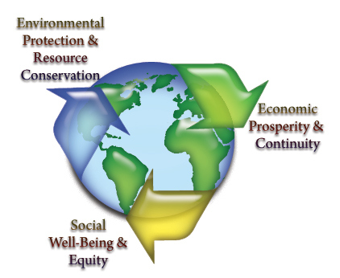
Energy and Sustainability
The three E’s [1]
General concerns before and during development:
  the reuse of materials and reduction of raw material
  reduction of power consumption
  use of eco-friendly materials

Slide 8
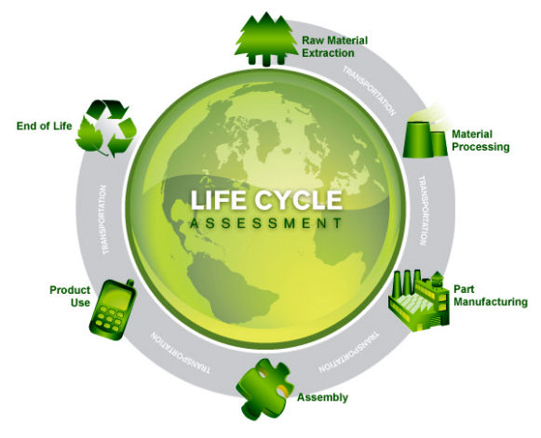
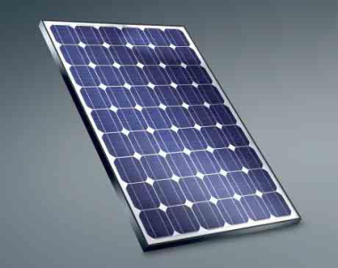
Energy and Sustainability
Materials for the prototype
  batteries
  electronic components
  fibreglass hull
  stainless steelstructure
LCA of the final product [2]
Future improvements
  solar panels [3]
  servomotor
  certificates and labels

Slide 9
Ethics and Deontology
General concerns
  Code of ethics
Four main ethical aspects:
  engineering ethics
  sales and marketing ethics
  academic ethics
  environmental ethics issue

Slide 10
Conclusions
Achievements:
  solid background knowledge about issues related to buoys ,
  profound research on required State of the Art,
  decent concept of steel structure,
  general architecture of buoy's electronics,
  first choices concerning some components,
  solid market analysis
  decisions how to apply sustainability in our project
Future Recommendations/Developments:
  choose and buy all components,
  create precise drawings: steel structure, electrical schematics, signals,
  figure out how to combine all components and build the prototype,
  do all necessary tests.

Slide 11
References & Bibliography
[1] California Student Sustainability Coalition, „The Three E’s of Sustainability,” [Online]. Available: http://www.sustainabilitycoalition.org/_excerpt/the-three-es-of-sustainability. [Accessed 6 April 2013].
[2] SolidWorks, „Life Cycle Assessment,” 2009. [Online]. Available: http://www.solidworks.com/sustainability/design/2722_ENU_HTML.htm. [Accessed 8 April 2013].
[3] Solar Power Resources, “Most Efficient Solar Panels In The Market,” [Online]. Available: http://www.ontario-sea.com/most-efficient-solar-panels-in-the-market/. [Accessed 10 April 2013].

